Slide 1
STOR 455 Class 29
Read: 10.1 - 10.4
Exercises: 10.19, 23, 24

Slide 2
Categorical Predictors with Multiple Categories in Logistic Regression
Example: Predicting survival in an intensive care unit (ICU)
Response
Predictor
Data in the Stat2Data package - ICU.csv

Slide 3
Categorical Predictors with Multiple Categories in Logistic Regression
Two approaches:
Method #1: Logistic regression for Survive with AgeGroup as a quantitative predictor.
Method #2: Use dummy (indicator) variables for the age categories as predictors in a logistic regression model for Survive.

Slide 4
Method #1: AgeGroup as Quantitative Pred
> ICUmod = glm(Survive~AgeGroup, data=ICU, family=binomial)
> summary(ICUmod)
Coefficients:
Estimate Std. Error z value Pr(>|z|)
(Intercept) 2.7566 0.5732 4.809 1.52e-06 ***
AgeGroup -0.6399 0.2414 -2.651 0.00802 **
---
Signif. codes: 0 ‘***’ 0.001 ‘**’ 0.01 ‘*’ 0.05 ‘.’ 0.1 ‘ ’ 1
(Dispersion parameter for binomial family taken to be 1)
Null deviance: 200.16 on 199 degrees of freedom
Residual deviance: 192.66 on 198 degrees of freedom

Slide 5
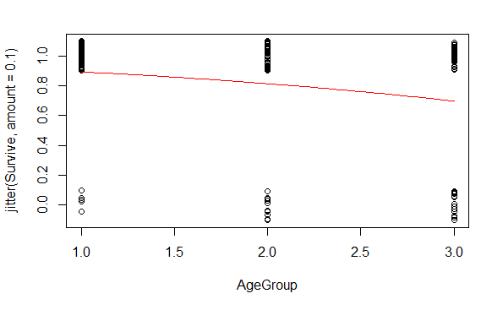
Method #1: AgeGroup as Quantitative Pred
> B0 = summary(ICUmod)$coef[1]
> B1 = summary(ICUmod)$coef[2]
> plot(jitter(Survive,amount=0.1)~AgeGroup,data=ICU)
> curve(logit(B0,B1,x),add=TRUE, col="red")

Slide 6
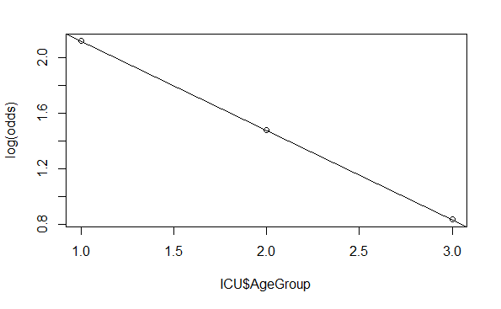
Method #1: AgeGroup as Quantitative Pred
> pi = logit(B0,B1,ICU$AgeGroup)
> odds = pi/(1-pi)
> plot(log(odds)~ICU$AgeGroup)
> abline(B0,B1)

Slide 7
Two-way Table: Survive by AgeGroup
ICU.table = table(ICU$Survive, ICU$AgeGroup)
ICU.prop.table = prop.table(ICU.table,2)
1 2 3
0 5 17 18
1 54 60 46
1 2 3
0 0.08474576 0.22077922 0.28125000
1 0.91525424 0.77922078 0.71875000

Slide 8
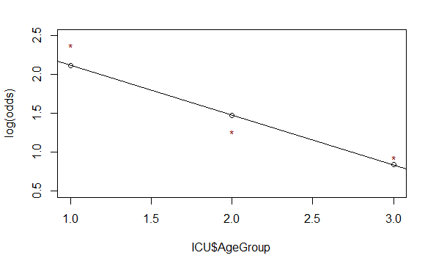
Two-way Table: Survive by AgeGroup
logodds.ICU.table = log(ICU.prop.table/(1-ICU.prop.table))
1 2 3
0 -2.3795461 -1.2611312 -0.9382696
1 2.3795461 1.2611312 0.9382696
logodds.ICU.df = t(as.data.frame.matrix(logodds.ICU.table))
plot(log(odds)~ICU$AgeGroup, ylim=c(.5, 2.5))
abline(B0,B1)
points(logodds.ICU.df[,2], col="dark red",pch="*")

Slide 9
Dummy Indicators for Multiple Categories
For a categorical predictor with k levels, we should use k − 1 dummy indicators.
...
What happens to Group #k?
Reference group
Constant term is an estimate for Group #k and other coefficients are the differences from it.

Slide 10
Binary Logistic Regression Model
Y = Binary response
X₁,X₂,…,X_{k} = Multiple predictors
X = Single predictor
π = proportion of 1’s (yes, success) at any x
π = proportion of 1’s at any x₁, x₂, …, x_{k}
Equivalent forms of the logistic regression model:
Logit form
Probability form

Slide 11
Method #2: Survive ~ Middle + Old
ICUmod.2 = glm(Survive~factor(AgeGroup), data=ICU, family=binomial)
summary(ICUmod.2)
Coefficients:
Estimate Std. Error z value Pr(>|z|)
(Intercept) 2.3795 0.4675 5.090 3.57e-07 ***
factor(AgeGroup)2 -1.1184 0.5422 -2.063 0.03915 *
factor(AgeGroup)3 -1.4413 0.5439 -2.650 0.00805 **
---
Signif. codes: 0 ‘***’ 0.001 ‘**’ 0.01 ‘*’ 0.05 ‘.’ 0.1 ‘ ’ 1
(Dispersion parameter for binomial family taken to be 1)
Null deviance: 200.16 on 199 degrees of freedom
Residual deviance: 191.59 on 197 degrees of freedom
AIC: 197.59

Slide 12
Interpreting Individual Tests
Similar issues to ordinary regression:
Is the predictor helpful, given the other predictors are already in the model?
Beware of problems due to multicollinearity.
Try to keep the model simple.

Slide 13

G-Test for Overall Fit
(Similar to regression ANOVA455)
H₀:β₁=β₂=…=β_{k}=0 vs. H_{a}: Some β_{i} ≠ 0
t.s. = G = improvement in –2log(L) over a model with just a constant term
Compare to χ² with k d.f.
# predictors
Null deviance: 200.16 on 199 degrees of freedom
Residual deviance: 191.59 on 197 degrees of freedom
$$G=200.16−191.59=8.57$$
1-pchisq(8.57,2)
[1] 0.01377362
Reject H₀

Slide 14
Method #2: Survive ~ Middle + Old
ICUmod.2 = glm(Survive~factor(AgeGroup), data=ICU, family=binomial)
summary(ICUmod.2)
log(odds) for Young
Coefficients:
Estimate Std. Error z value Pr(>|z|)
(Intercept) 2.3795 0.4675 5.090 3.57e-07 ***
factor(AgeGroup)2 -1.1184 0.5422 -2.063 0.03915 *
factor(AgeGroup)3 -1.4413 0.5439 -2.650 0.00805 **
Change in log(odds) for Middle and Old—compared to Young
1-pchisq(ICUmod.2$null.deviance - ICUmod.2$deviance, ICUmod.2$df.null - ICUmod.2$df.residual)
[1] 0.01375896

Slide 15
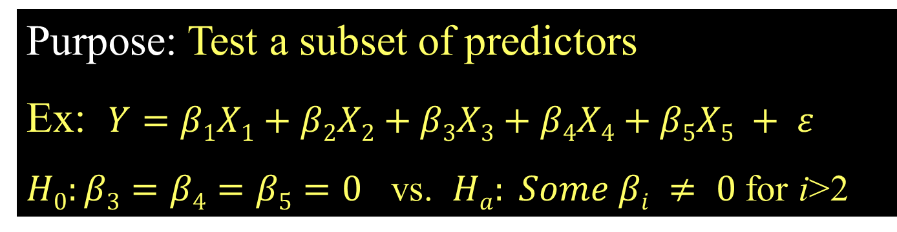
Recall: Nested F-test
Purpose: Test a subset of predictors
Ex: $Y=β1X1+β2X2+β3X3+β4X4+β5X5 + ε$
$H0:β3=β4=β5=0$ vs. $Ha: Some βi ≠ 0$for i>2
Basic idea: Is the improvement (reduction in SSE) “significant” for the number of extra predictors?
i.e. Compare “full” model to “reduced” model
t.s.= F-ratio (interpret similar to ANOVA)

Slide 16
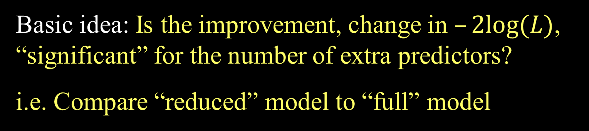
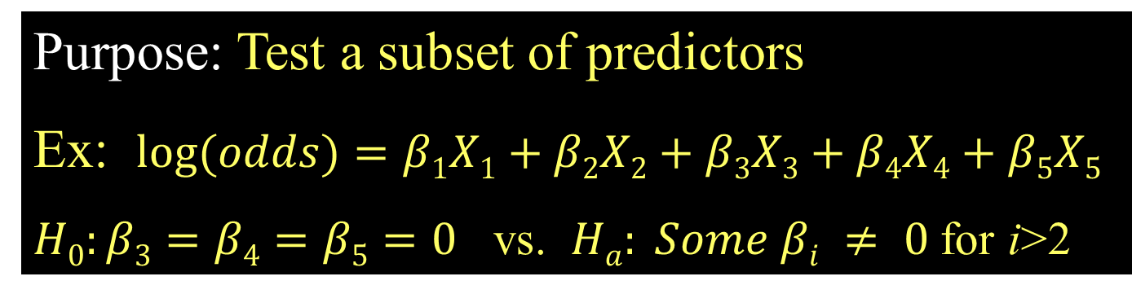
Nested LRT for Logistic Regression (Likelihood Ratio Test)
Purpose: Test a subset of predictors
Ex: $log⁡(odds)=β1X1+β2X2+β3X3+β4X4+β5X5$
$H0:β3=β4=β5=0$ vs. $Ha: Some βi ≠ 0$for i>2
Basic idea: Is the improvement, change in $–2log⁡(L)$, “significant” for the number of extra predictors?
i.e. Compare “reduced” model to “full” model
$χ^{2}=–2log⁡(LReduced) – (–2log⁡(LFull))$
Chi-square d.f.=#extra predictors tested

Slide 17
Comparing Full to Reduced Models
ICUmod.3 = glm(Survive~factor(AgeGroup)+Emergency, data=ICU, family=binomial)
Null deviance: 200.16 on 199 degrees of freedom
Residual deviance: 171.16 on 196 degrees of freedom
FULL
ICUmod.2 = glm(Survive~factor(AgeGroup), data=ICU, family=binomial)
Null deviance: 200.16 on 199 degrees of freedom
Residual deviance: 191.59 on 197 degrees of freedom
Reduced
$H0:β3=0$ vs. $Ha: β3 ≠ 0$
1 - pchisq(summary(ICUmod.2)$deviance - summary(ICUmod.3)$deviance, 1)
Reject H₀ (p-value= 6.187652e-06). The Emergency term significantly improves the model.
This is also often called a “Drop-in-Deviance” test.

Slide 18
Example: Predicting Medical School Acceptance
Data: MedGPA
Accept Status: A=accepted to medical school or D=denied admission
Acceptance Indicator for Accept: 1=accepted or 0=denied
Sex F=female or M=male
BCPM Bio/Chem/Physics/Math grade point average
GPA College grade point average
VR Verbal reasoning (subscore)
PS Physical sciences (subscore)
WS Writing sample (subcore)
BS Biological sciences (subscore)
MCAT Score on the MCAT exam (sum of CR+PS+WS+BS)
Apps Number of medical schools applied to
Find the “best” model for Acceptance using some or all of these predictors.

Slide 19
Criteria to Compare Models for Ordinary Multiple Regression
Look for large R²
But R² is always best for the model with all predictors
Look for large adjusted R²
Helps factor in the number of predictors in the model
Look at individual t-tests
Might be susceptible to multicollinearity problems

Slide 20

How to Choose Models to Compare for Ordinary Multiple Regression?
Method #1:
All Subsets!
Consider all possible combinations of predictors.
How many are there?
Pool of k predictors ⇒
$2k−1$ subsets
Advantage: Find the best model for your criteria
Disadvantage: LOTS of computation

Slide 21
Best Subsets for MedGPA
#requires the leaps package
library(leaps)
#Ask for the best model of each size
all = regsubsets(Acceptance~, data=MedGPA[,2:11])
#show the predictors in “best” models of various sizes
summary(all)
This “works” in the sense that it runs, but creates a linear not a logistic model…

Slide 22
Predictor Selection Methods for Logistic Regression
All subsets Not with leaps package
Backward elimination?
Forward selection?
Stepwise regression?

Slide 23
Is there a package in R to automate this process?
Yes! The package bestglm is one that can be used.
Great! Can you show us how to use it?
No! Not yet…

